Slide 1
Computer Networks
Gu Qing, Xia Nai
Nanjing University
2011年9月13日

Slide 2
Chapter 5. End-to-End Protocols
Transport Services and Mechanisms
User Datagram Protocol (UDP)
Transmission Control Protocol (TCP)
TCP Congestion Control
Real-time Transport Protocol (RTP)
Session Initiation Protocol (SIP)
Real Time Streaming Protocol (RTSP)

Slide 3
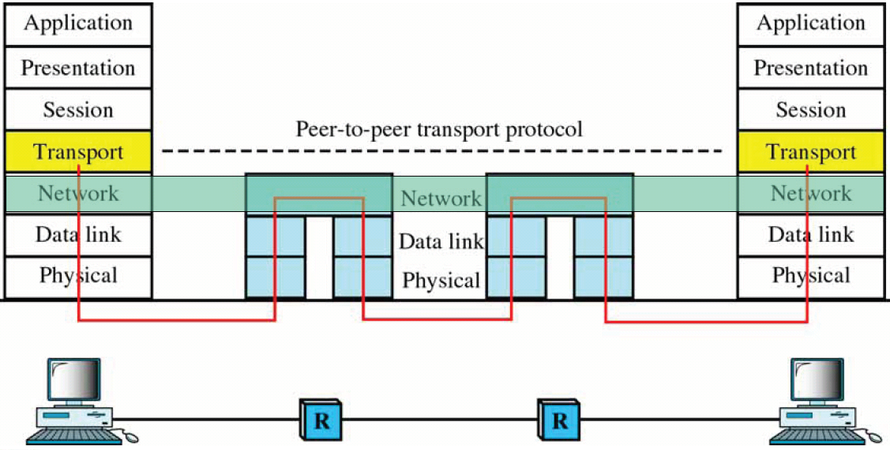
Transport Services and Mechanisms
The Transport Layer
Application
Application
IP
Network 1
Network 2
Network 3

Slide 4
Internet Transport Services
Provide logical communication between app processes running on different hosts
Transport protocols run in end systems
Send side: breaks app messages into segments, passes to network layer
Receive side: reassembles segments into messages, passes to app layer
More than one transport protocol available to apps
Internet: TCP and UDP
application
transport
network
data link
physical
network
data link
physical
network
data link
physical
network
data link
physical
logical end-end transport
network
data link
physical
network
data link
physical
application
transport
network
data link
physical

Slide 5
Internet Transport-Layer Protocols
Reliable, in-order delivery (TCP)
Connection oriented
Congestion control
Flow control
Unreliable, unordered delivery (UDP)
No-frills extension of “best-effort” IP
application
transport
network
data link
physical
network
data link
physical
network
data link
physical
network
data link
physical
logical end-end transport
network
data link
physical
network
data link
physical
application
transport
network
data link
physical

Slide 6
Internet Transport Mechanisms
Addressing and multiplexing
Connection-oriented mechanisms
Flow control
Connection establishment and termination
Reliable sequencing communication

Slide 7
Addressing
3-level address for application processes on hosts
Process identification
SAP on transport entity, represents a particular transport service (TS) user
Port number on TCP/UDP
Transport entity identification
Generally only one of each type per host
Transport protocol identity (TCP, UDP)
Host address
A global Internet address for attached hosts
Internet TCP/UDP addressing
<HostIP, Port>, called a socket
Notes:
Service Access Point
Port number specified for UDP or TCP

Slide 8
Finding Addresses
How TS user get to know each other
Target port: use conventions
4 methods can be used for target host
Know address ahead of time
Well known addresses
Name server, directory service
Sending process request to known address
Create a TS user on target host

Slide 9
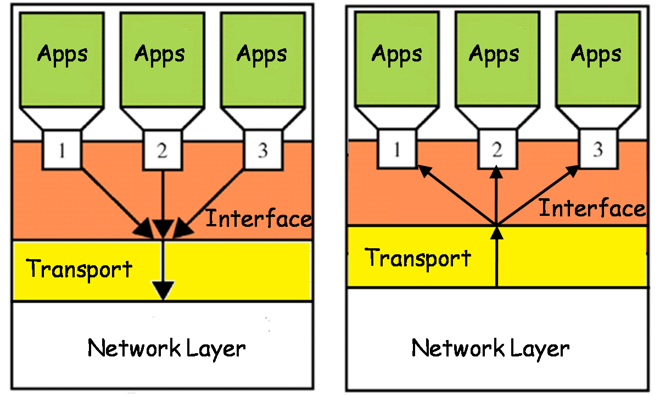
Multiplexing
32 bits
source port #
dest port #
Multiple users employ same transport entity
other header fields
application
data
(message)

Slide 10
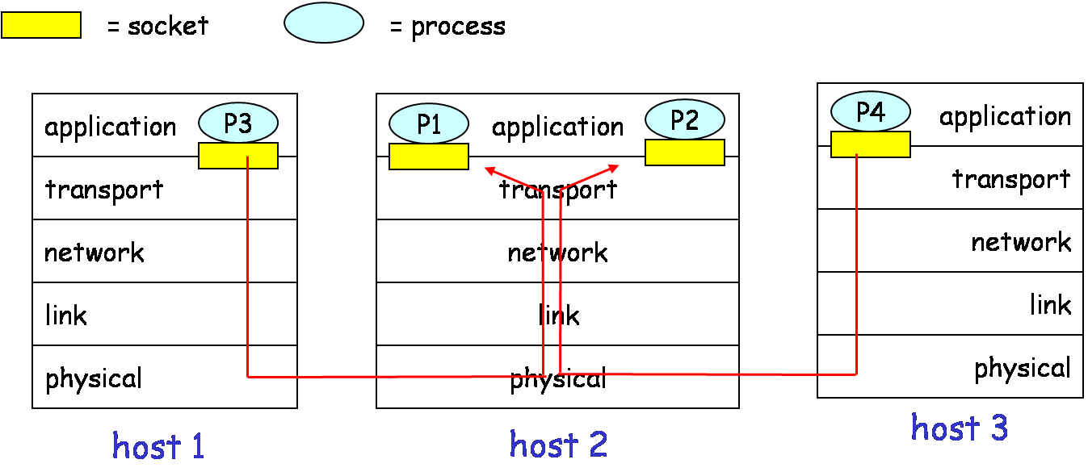
Multiplexing / Demultiplexing
Multiplexing at send host:
Demultiplexing at rcv host:
Gathering data from multiple
sockets, enveloping data with
header (for demultiplexing)
Delivering received segments
to correct socket

Slide 11
Demultiplexing
TE receives IP datagrams
Each datagram carries 1 transport-layer segment
Each datagram has source IP address, destination IP address
Each segment has source, destination port number
TE uses IP addresses & port numbers to direct segment to appropriate socket
32 bits
source port #
dest port #
other header fields
application
data
(message)
TCP/UDP segment format
Notes:
Transport Entity

Slide 12
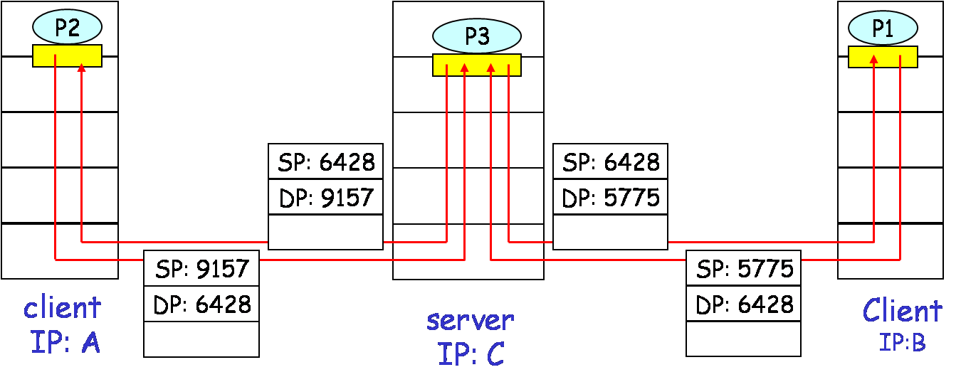
Demultiplexing in UDP
DatagramSocket serverSocket = new DatagramSocket(6428);
SP provides “return address”
Notes:
Source port and Destination port

Slide 13
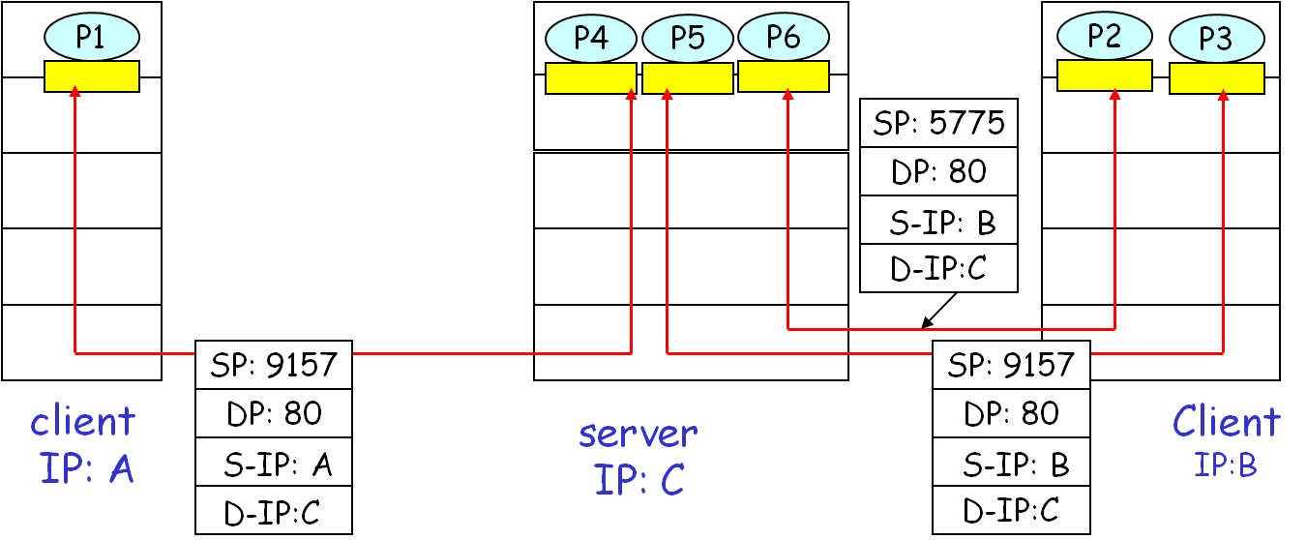
Demultiplexing in TCP
TCP connection identified by 4-tuple:
<Source IP, Source Port, Destination IP, Destination Port>

Slide 14
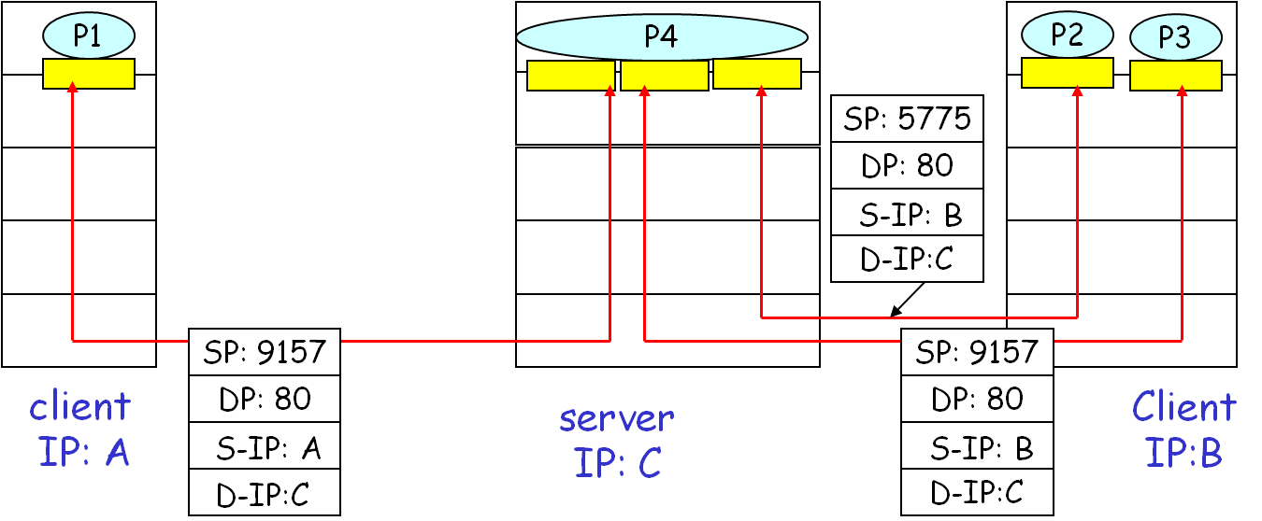
Threaded Web Server
Application with multiple threads, can be seen as a downward multiplexing

Slide 15
Flow Control
Flow control in multi-layers
Sender won’t overflow receiver’s buffer by transmitting too much too fast
The receiving TS user can not keep up
Transport buffer may overflow
The receiving transport entity can not keep up
Network buffer may overflow
Speed-matching service
Matching the send rate to the receiving app’s receive rate
Notes:
Single buffer pool used in TCP/IP transport
Multiplexed by multiple TCP connections

Slide 16
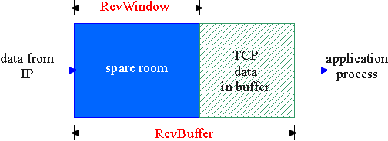
Receive Buffer
The receive side of TS connection has a receive buffer
App process may be slow at reading from buffer
Notes:
Transport buffer

Slide 17
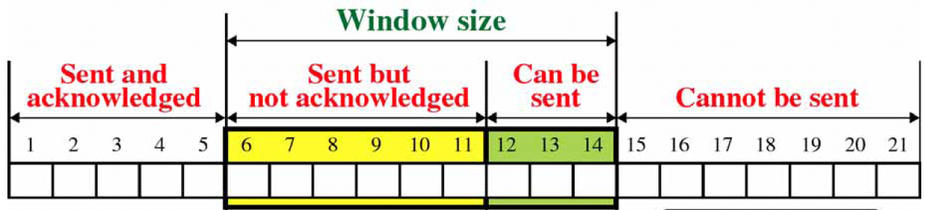
Handle Flow Control
Fixed sliding window
Works well on reliable direct links
Problem:
Failure to receive ACK is taken as flow control indication
Can not distinguish between lost segment and flow control
Not flexible for congestion control mandated in Internet
Notes:
fixed sliding window: ACK → sliding

Slide 18
Credit Scheme (1)
Rcvr advertises spare room (credits) by including value of RcvWindow in segments
Sender limits unACKed data to RcvWindow
Spare room in receive buffer
RcvWindow = RcvBuffer –[LastByteRcvd – LastByteRead]

Slide 19
Credit Scheme (2)
Greater control on Internet
Decouples flow control from ACK
May ACK without granting credit
Each octet has a sequence number
Each transport segment has seq number, ack number and window size in header
32 bits
Source port #
Dest port #
Sequence number
ACK number
Win size
other header fields
application
data
(message)
TCP segment format

Slide 20
Use of Header Fields
When sending a segment
seq number (SN) is that of first octet in segment
ACK includes AN=i, W=j
All octets through SN=i–1 acknowledged
Next expected octet is i
Permission to send additional window of W=j octets
i.e. octets from i to i+j–1

Slide 21
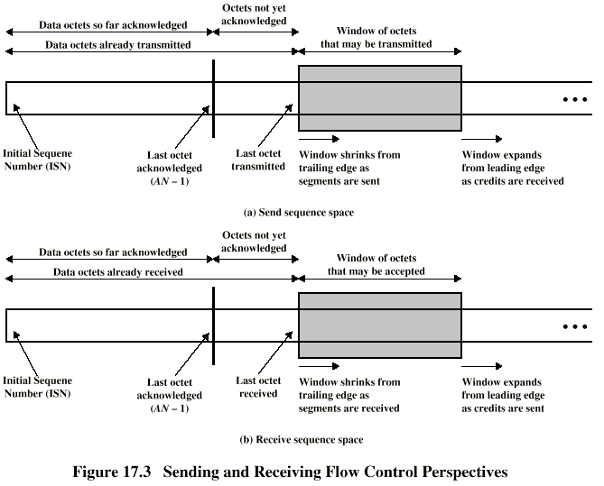
Sending and Receiving Windows

Slide 22
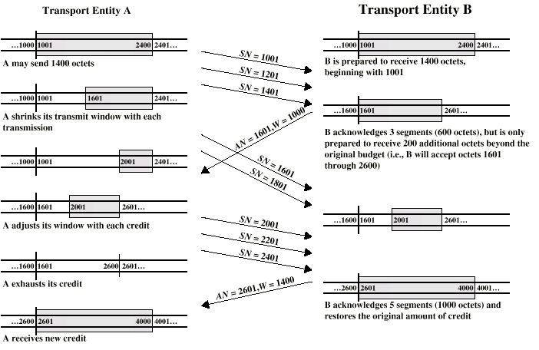
Credit Allocation Procedure
200 octets per segment

Slide 23
Connection Establishment and Termination
2 ends establish connection before exchanging data segments
Allow each end to know the other exists
Negotiation of optional parameters
e.g. initial seq numbers, max segment size, max window size, IP QOS
Allocation of transport entity resources
e.g. buffers
Gets mutual agreement
On reliable sequencing networks
On unreliable IP internets
Notes:
需同步

Slide 24
Reliable Sequencing Network Service
Assume arbitrary length message delivered in sequence
Assume virtually 100% reliable delivery by network service
Examples
Reliable packet switched network using X.25
Frame relay using LAPF control protocol
IEEE 802.3 using connection oriented LLC service
Notes:
LAPF: Link Access Procedure for Frame

Slide 25
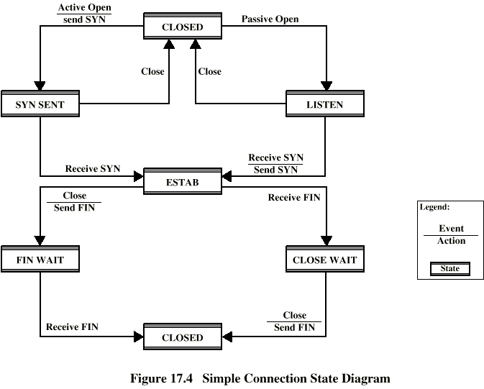
Simple Connection State Diagram

Slide 26
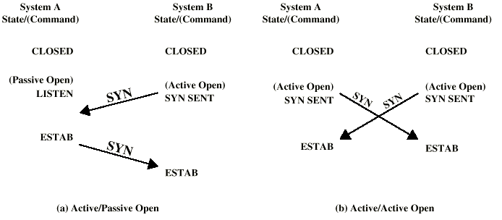
Connection Establishment

Slide 27
Handle Pending Request
SYN comes while requested TS user is not listening
Reject with RST (Reset)
Queue request until matching open issued
Signal TS user to notify of pending request
Just accept without passive open

Slide 28
Termination
Either or both sides issue terminate
Reach mutual agreement
Abrupt termination
Pending segments from other end may lost
Graceful termination
All outstanding data is transmitted from both sides
Both sides agree to terminate

Slide 29
Side Initiating Termination
TS user issues Close request
Transport entity sends FIN, requesting termination
Connection placed in FIN Wait state
Continues to accept data and deliver data to user
Not sends any more data
When FIN received, inform user and close connection

Slide 30
Side Not Initiating Termination
FIN received, Inform TS user
No more data come from the other end
Place connection in CLOSE Wait state
Continue to accept data from TS user and transmit it
TS user issues CLOSE primitive
Transport entity sends FIN
Connection closed

Slide 31
Unreliable Network Service
Segments may get lost
Segments may arrive out of order
Examples
Internet using IP
Frame relay using LAPF core
IEEE 802.3 using unacknowledged connectionless LLC

Slide 32
Connection Establishment
2-way handshake
A sends SYN, B replies with SYN
Lost SYNs handled by re-transmission
Ignore duplicate SYNs once connected
Problem
How to recognize slipped segments from old connection
How to recognize duplicated obsolete SYN
Handle
SYN with start seq number i far removed from previous connection
ACK SYN, use 3-way handshake

Slide 33
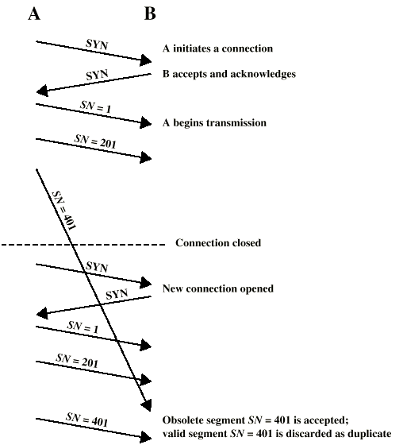
2-Way Handshake: Slipped Data Segment

Slide 34
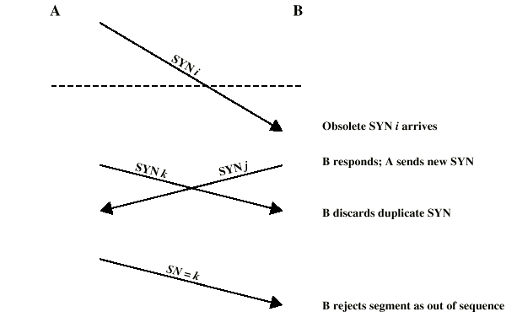
2-Way Handshake: Obsolete SYN
Notes:
B considers connect but A does not
未同步

Slide 35
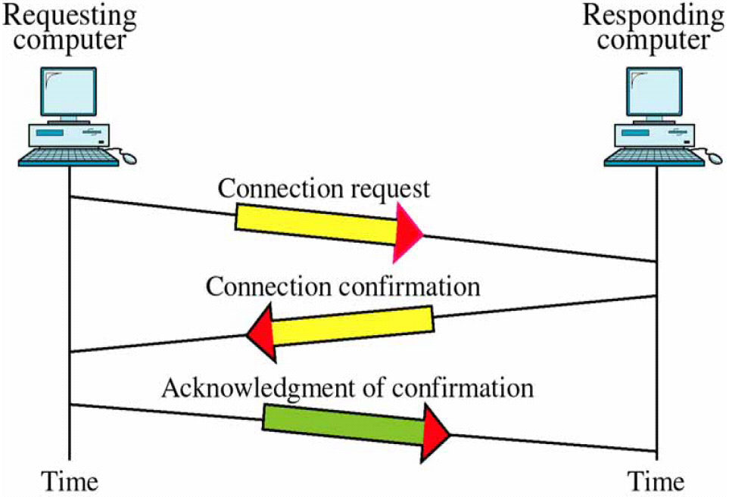
3-Way Handshake

Slide 36
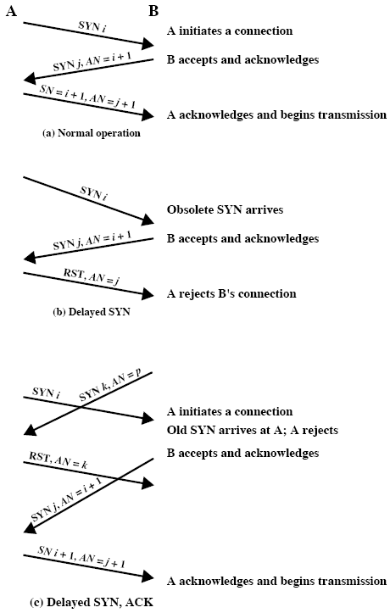
3-Way Handshake: Examples

Slide 37
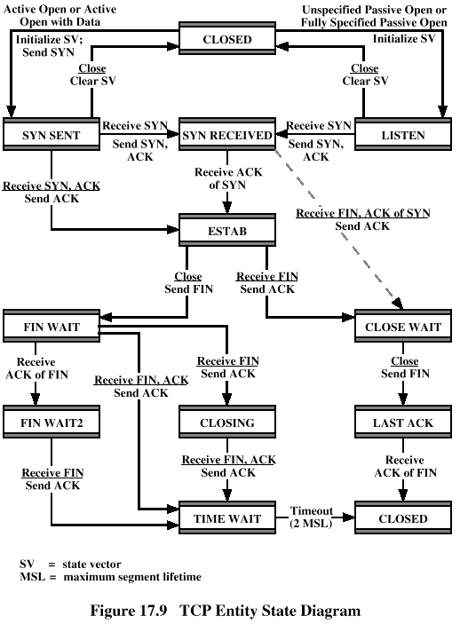
3-Way Handshake: State Diagram
Notes:
客户端：主动Open，主动Close

Slide 38
Connection Termination
A problem with 2-way termination
Entity in CLOSE Wait state sends last data segment, followed by FIN
FIN arrives before last data segment
Receiver accepts FIN and closes connection
Now last data segment lost
Handle
Associate sequence number with FIN
Receiver waits for all segments before FIN seq number
ACK FIN, use 3-way termination
Notes:
避免两方失去同步：即只有一方认为终止

Slide 39
Graceful Close
client
server
User close
FIN Wait_1
FIN i
CLOSE Wait
ACK i+1
FIN Wait_2
User close
LAST ACK
FIN j
TIME Wait
ACK j+1
timed wait
CLOSED
CLOSED
Q: What does TIME Wait stand for?
Notes:
Assure lost segments run out of TTL
Assure ACK j+1 received

Slide 40
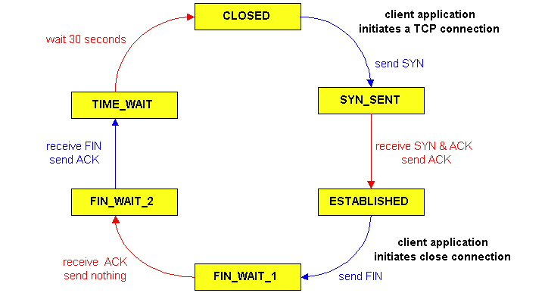
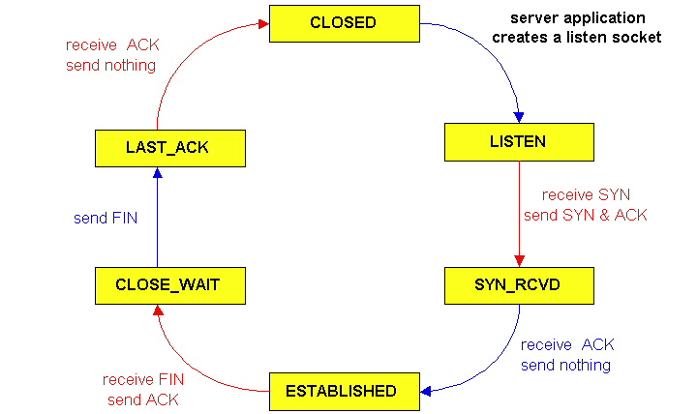
State Diagram: Client and Server
TCP server
lifecycle
TCP client
lifecycle

Slide 41
Crash Recovery
Problem
If a side restarts, all state info is lost
Connection is half open now
Side that did not crash still thinks it is connected
Handle
Close connection using Persistence Timer
Wait for ACK for (timeout) × (number of retries)
When expired, close connection and inform user
Restarted side sends RST i in response to any i segment arriving
Other side verifies RST i, then closes connection
Restarted user can reconnect immediately

Slide 42
Reliable Communication
Ordered Delivery
Retransmission strategy
Duplication detection

Slide 43
Ordered Delivery
Problem
Segments may arrive out of order
Handle
Number segments sequentially
TCP numbers each octet sequentially
Segments are numbered by the first octet number in the segment

Slide 44
Retransmission Strategy
Problem
Segment damaged in transit, or
Segment dropped due to buffer overflow at router
Sender may not know of failure
Handle
Receiver: acknowledge successful receipt
Can use cumulative acknowledgement
Sender: waiting Timer for ACK timeout triggers re-transmission

Slide 45
Setting Re-transmission Timer
Should adapt to changing network conditions
Fixed timer is not suitable
Too small leads to unnecessary re-transmissions
Too large and response to lost segments is slow
Can be set a bit longer than round-trip time
Receiver may not ACK immediately
Sender can not distinguish between ACK of original segment and re-transmitted segment
Should adapt to network congestion

Slide 46
Window Timer
Credit allocation deadlock
Segment with AN=i, W=0 closing rcv-window
Should send AN=i, W=j to reopen, but this maybe lost
Now sender thinks window is closed, receiver thinks it is open and wait
Handle
Use window timer
If timer expires without any receiving, send something
Could be re-transmission of previous segment
Notes:
（更可能是提升性能）纯ACK不占序号

Slide 47
Duplication Detection
If re-transmission Timer timeout, sender re-transmits segment
If segment just delayed, receiver must recognize duplicates
Duplicate received within a connection
Receiver assumes ACK lost and re-transmits ACKs
Sender must not get confused with multiple ACKs
Space of seq number should be large enough to not cycle within maximum life of segment
Duplicate received after connection closed

Slide 48
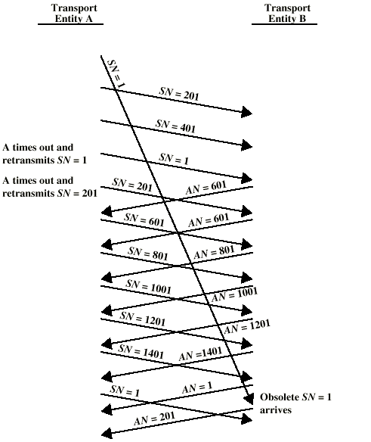
Incorrect Duplicate Detection (1)
Seq number cycled within life of a segment
Q: How to handle it?
Notes:
TCP: segment不定长；IP: 数据报生存期

Slide 49

Incorrect Duplicate Detection (2)
Segments slipped into another connection
Q: How to handle it?
Notes:
TCP: 初始序号设置，连接终止等待；应用: port不重用

Slide 50
User Datagram Protocol (UDP)
User datagram protocol, RFC 768
Connectionless service for application level processes
Unreliable, “best-effort” of IP
Each UDP segment handled independently of others
Delivery and duplication control not guaranteed
Simple and reduced overhead
No connection establishment
No connection state at sender, receiver
Small segment header

Slide 51
UDP Uses
Normal use
Inward data collection from sensors
Outward data dissemination
Real time applications
Request-Response (e.g. RPC), add reliability at application layer
Example Apps based on UDP
DNS
SNMP
Notes:
DNS: Domain Name System
SNMP: Simple Network Management Protocol

Slide 52
UDP Segment Format
32 bits
Length in octets, including Header and Data
source port #
dest port #
length
checksum
Application
data
(message)
Pseudo-Header for Checksum
source IP
destination IP
pad
proto
total length

Slide 53
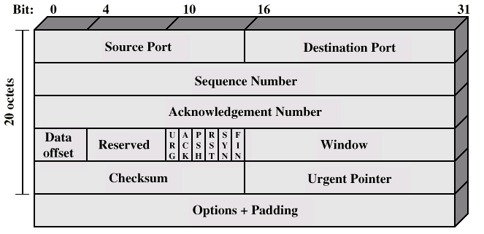
Transmission Control Protocol (TCP)
Reliable communication between pairs of processes
Across variety of reliable and unreliable networks and internets

Slide 54
TCP Header Fields (1)
Source port (16 bits)
Destination port (16 bits)
Identify src and dest TCP user
Sequence number (32 bits)
Seq number of first data octet
If SYN is set, it is ISN and first data octet is ISN+1
ACK number (32 bits)
Piggybacked ACK
Window (16 bits)
Credit allocation in octets, i.e. rcv_window of sender
Notes:
ISN: Initial Sequence Number

Slide 55
TCP Header Fields (2)
Data offset (4 bits)
Number of 32-bit words in the header
Largest data offset is 15×4=60 octets
Checksum (16 bits)
Header + Data + Pseudo-header (src IP, dest IP, protocol No, total length)
Reserved (6 bits)
Options (Variable)
e.g. Maximum segment size the sender can accept
or Max value of rcv_window

Slide 56
TCP Header Fields (3)
Flags (6 bits):
URG: urgent pointer field meaningful
ACK: acknowledgment field meaningful
PSH: push function
RST: reset the connection
SYN: synchronize the sequence number
FIN: no more data from sender
Urgent Pointer (16 bits)
Points to last octet in a sequence of urgent data
Notes:
Set 1 to be useful

Slide 57
Parameters Passed to IP
TCP passes QOS parameters down to IP
Precedence
Normal delay / low delay
Normal throughput / high throughput
Normal reliability / high reliability
IPv4 “Type of Service” or IPv6 “Traffic Class”

Slide 58
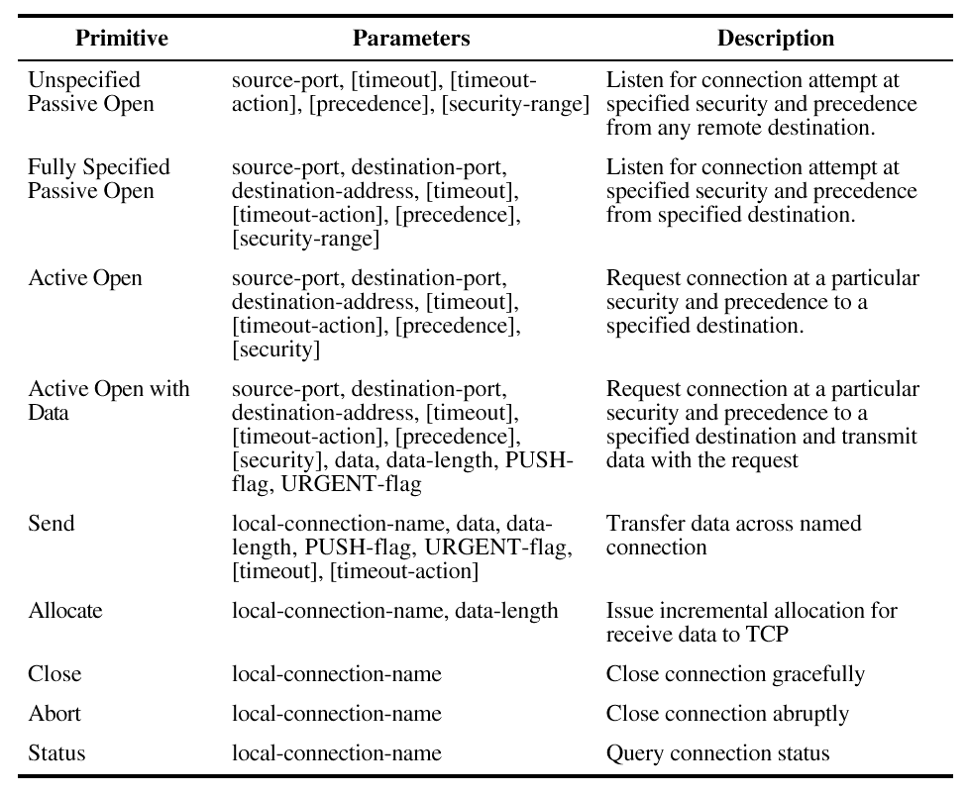
TCP Service Request Primitives
Notes:
从上而下

Slide 59
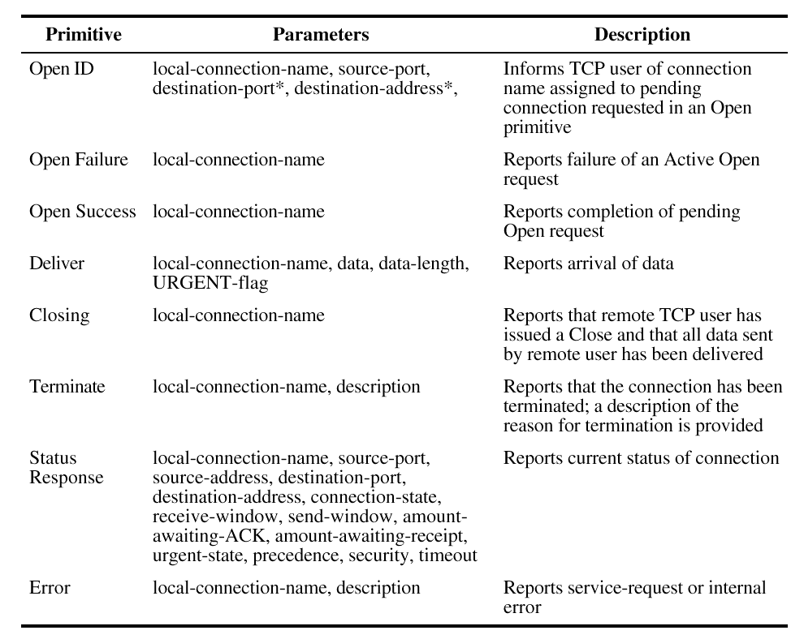
TCP Service Response Primitives
Notes:
从下而上

Slide 60
TCP Mechanisms (1)
Connection establishment
3-way handshake
Between pairs of ports
One port can connect to multiple destination ports
Connection termination
Graceful termination: CLOSE + FIN
Abrupt termination: ABORT + RST

Slide 61
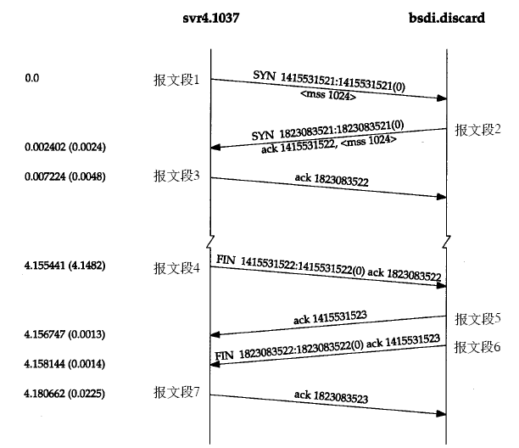
Illustration of Connection establishment & Termination
Notes:
MSS: maximum segment size

Slide 62
TCP Mechanisms (2)
Data transfer
Logical stream of octets
Octets numbered modulo 2³²
Flow control by credit allocation of number of octets
Data buffered at sender and receiver
User sets PUSH to force data transmission immediately
User may specify a block of data as urgent

Slide 63
Implementation Policy
Send
Deliver
Accept
Retransmit
Acknowledge
Notes:
考虑位置：应用→TCP→IP

Slide 64
Send
If no PUSH or CLOSE, TCP entity transmits at its own convenience
Data issued by TCP user buffered at transmit buffer
May construct segment per data batch
May wait for certain amount of data

Slide 65
Deliver
In absence of PUSH, TCP entity delivers data at own convenience
May deliver as each segment in order received
Deliveries (I/O interrupts) are frequent and small
May buffer data from more than one segment
Deliveries are infrequent and large

Slide 66
Accept
Segments may arrive out of order
In order
Only accept segments in order
Discard out of order segments
Makes for a simpler implementation
In windows
Accept all segments within receive window
Can reduce retransmission

Slide 67
Retransmit
TCP entity maintains queue of segments transmitted but not acknowledged
TCP will retransmit if not ACKed in given time
First only: one timer a queue, reset the timer after retransmission of first segment in queue
Batch: one timer a queue, reset after retransmission of all segments in queue
Individual: one timer each segment, reset after retransmission

Slide 68
Fast Retransmit
Time-out period often relatively long
Detect lost segments via duplicate ACKs
If segment is lost, there will likely be many duplicate ACKs
If a TCP entity receives 3 ACKs for the same data, then segments after ACKed data must be lost
Trigger fast retransmit: resend segment before timer expires

Slide 69
Acknowledgement
Immediate or Cumulative
Event at Receiver
Arrival of in-order segment with
expected seq #. All data up to
expected seq # already ACKed
Arrival of in-order segment with
expected seq #. One other
segment has ACK pending
Arrival of out-of-order segment
higher-than-expect seq. # .
Gap detected
Arrival of segment that
partially or completely fills gap
TCP Receiver action
Delayed ACK. Wait up to 500ms
for next segment. If no next segment,
send ACK
Immediately send single cumulative
ACK, ACKing both in-order segments
Immediately send duplicate ACK,
indicating seq. # of next expected byte
Immediate send ACK, provided that
segment sat at lower end of gap

Slide 70
TCP Congestion Control
Congestion control
Too many sources sending too much data too fast for Internet to handle
RFC 1122, Requirements for Internet hosts
End to end control, no network assistance
Retransmission timer
Window management

Slide 71
Retransmission Timer Management
Estimate round trip delay by observing delay pattern
Simple average
Exponential average
Set timer to value somewhat greater than estimate
RFC 793
RTT Variance Estimation (Jacobson’s algorithm)
How to set timer after retransmission
Exponential RTO backoff algorithm
When to sample the round trip delay
Karn’s Algorithm

Slide 72
Simple Average
Term
RTT(i): round-trip time observed for the i^{th} transmitted segment
ARTT(k): average round-trip time for the first k segments
Expression

Slide 73
Exponential Average
Term
SRTT(k): smoothed round-trip time estimate for the first k segments
Expression
Notes:
指数平均

Slide 74
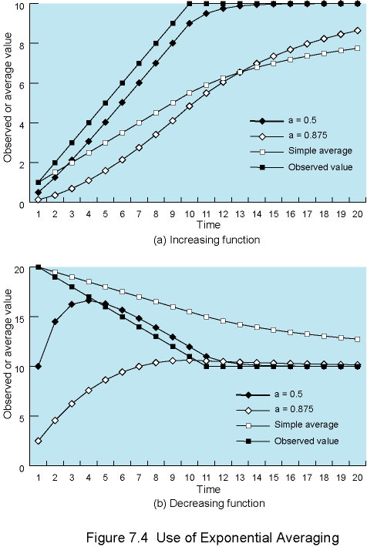
Simple and Exponential Averaging

Slide 75
RFC 793
Term
RTO(k): retransmission timeout, i.e. the timer after the first k segments
Expression
Retransmission timer set between LBOUND~UBOUND
Suggested values, α: 0.8~0.9, β: 1.3~2.0

Slide 76
Jacobson’s Algorithm (1)
Problem in RFC 793
Not counting variance of RTT (network stability)
When network is stable, RTT variance is low, but β=1.3 gives a higher RTO
When network is unstable, RTT variance is high, β=2 is inadequate to protect against retransmissions

Slide 77
Jacobson’s Algorithm (2)
Term
SERR(k): smoothed error estimate, difference of round-trip time of segment k and the current SRTT
SDEV(k): standard deviation for round-trip time of first k segments
Expression

Slide 78
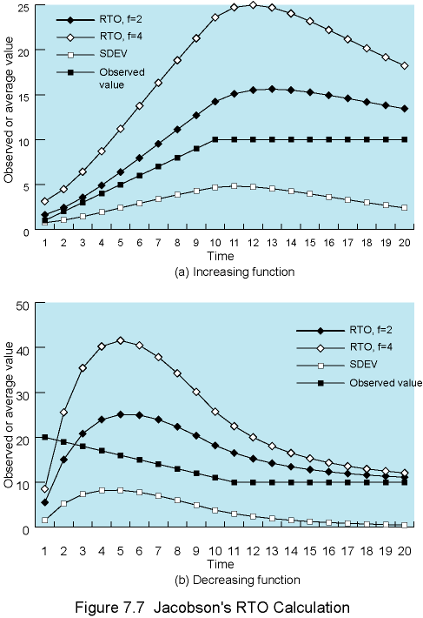
Jacobson’s RTO Calculation

Slide 79
Exponential RTO Backoff
Timeout is often due to congestion by dropped packet or long round trip
Should slow down end system transmission
Maintaining RTO is not a good idea
Similar to Binary exponential backoff in Ethernet
RTO multiplied each time a segment is re-transmitted
RTO = q×RTO
Commonly q=2

Slide 80
Karn’s Algorithm
The problem
If a segment is re-transmitted, the ACK arriving may be
For the first copy of the segment, or for the second copy, or others
No way to tell
RTT Sampling
Do not measure RTT for re-transmitted segments
Calculate RTO backoff when re-transmission occurs
Until ACK arrives for segment that has not been re-transmitted
Begin sampling, stop RTO backoff

Slide 81
Window Management
Add congestion (send) window besides the credit (receive window)
awind = Min(credit, cwnd)
awnd: allowed window, in MSS (maximum segment size)
credit: the amount of unused credit granted in last ACK, in MSS
cwnd: congestion window, in MSS
Manage congestion window
Slow Start: exponentially expending the cwnd at start of connection
Dynamic Window on Congestion: shrinking / expending the cwnd with stages when retransmission occurs
Notes:
Slow start + linear

Slide 82
Slow Start
When connection begins, cwnd = 1 MSS
Each time an ACK received, cwnd increased by ACKed number of MSSs until Max value reached
cwnd increased exponentially until first loss event occurs
Timeout or 3 duplicate ACKs
Host A
Host B
one segment
RTT
two segments
four segments
time

Slide 83
Dynamic Windows Sizing
By Jacobson, set slow start threshold ssthresh = cwnd/2
After 3 duplicate ACKs
Network still capable of delivering some segments
cwnd is set to be ssthresh
cwnd increases by 1 (linearly instead of exponentially) after each RTT or ACK received
After timeout event
cwnd is set to 1
Same as Slow Start until cwnd reaches ssthresh
cwnd increases by 1 after each RTT or ACK received

Slide 84
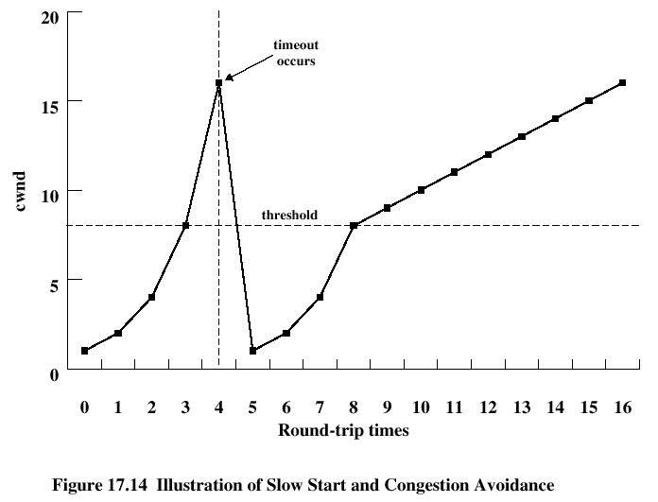
Illustration of Window Management
ssthresh = cwnd/2

Slide 85
New Window Management Algorithm
Problem of linear increase
Many long fat networks: large bandwidth with long delay
Slow response of TCP in such networks leaves sizeable unused bandwidth
An example
A TCP connection with 1250-Octet MSS and 100ms RTT on 10Gbps network
To fully use the network, credit is big, and nearly 1.4 hour is needed for linear increase

Slide 86
Too Slow Linear Increase
Q: how to improve it
slow
increase
1.4 hours
1.4 hours
1.4 hours
Packet loss
Packet loss
Packet loss
Packet loss
TCP
cwnd
100,000
10Gbps
50,000
5Gbps
Slow start
Congestion avoidance
Time (RTT)
Notes:
Threshold and increase unit

Slide 87
BIC and CUBIC
BIC (Binary Increase Congestion control)
Implemented and used by default in Linux kernels 2.6.8
CUBIC
The window is a cubic function of time since the last congestion event
Implemented and used by default in Linux kernels 2.6.19 and above

Slide 88
BIC
BIC adaptively increase cwnd, and decrease cwnd by 1/8
cwnd = cwnd + 1
cwnd = cwnd + f(cwnd, history)
cwnd = cwnd * (1-1/2)
cwnd = cwnd * (1-1/8)
Packet loss
Packet loss
Packet loss
Packet loss
TCP
cwnd
Slow start
Congestion avoidance
Time (RTT)

Slide 89
BIC Overview
2 stages
Binary Search: increase window after congestion
Max Probing: search for better window size (until max credit)
4 parameters defined
Smax : the maximum increment, e.g. 1/8×credit
Smin : the minimum increment, e.g. 2 MSS
Wmax : maximum window size of current search, e.g. window size just before the lost
Wmin : minimum window size of current search, e.g. current window size without lost

Slide 90
BIC Stages
Additive Increase
Linear increase with inc
Binary search
How to set inc
while (Wmin <= Wmax){
inc = (Wmin+Wmax)/2 - cwnd;
if (inc > Smax) inc = Smax;
else if (inc < Smin) inc = Smin;
cwnd += inc;
if (no packet losses) Wmin = cwnd;
else {
Wmax = cwnd;
Wmin = cwnd×β (e.g. 0.8)
}
}

Slide 91
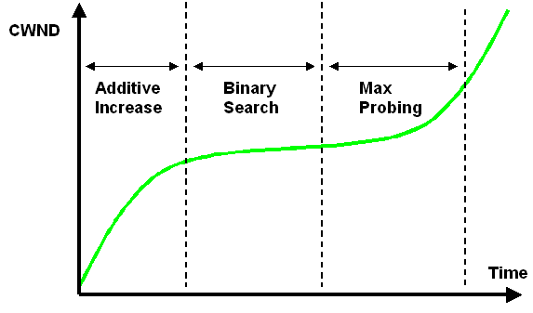
BIC Stages
Binary Search Stage: Additive increase + Binary search
Max Probing Stage: Binary search + Additive increase

Slide 92
CUBIC
BIC problem
The BIC’s growth function may be too aggressive for TCP
BIC is not suitable for short RTT or low speed networks
Handle
Express the multi-stage BIC curve with a single cubic function

Slide 93
CUBIC Overview
Parameters
Wcubic: current cwnd
Wmax: window size just before the last lost
T: elapsed time from the last lost
C: a scaling constant
Function

Slide 94
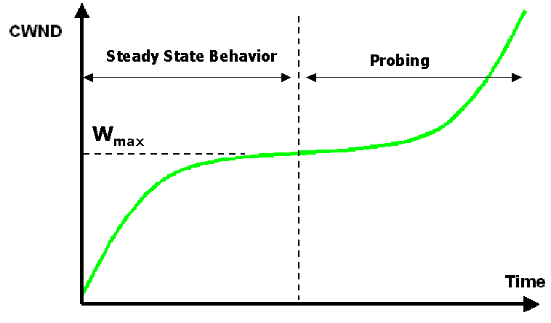
CUBIC Overview

Slide 95
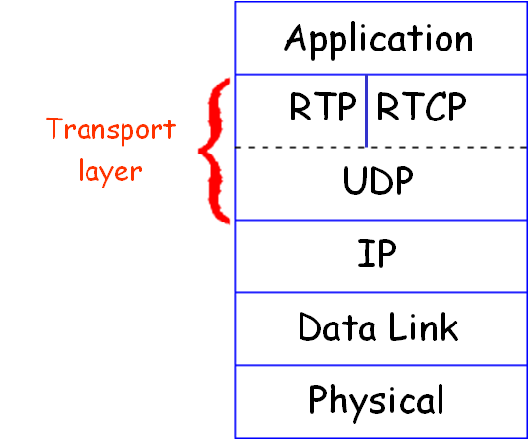
Real-time Transport Protocol (RTP)
RFC 3550
Built upon UDP, i.e. RTP packets encapsulated in UDP segments
Specifies packet structure for packets carrying audio, video data
RTP packet provides
Payload type identification
Packet sequence numbering
Time stamping
Notes:
Used by application-layer protocol: Real-Time Streaming Protocol (RTSP)

Slide 96
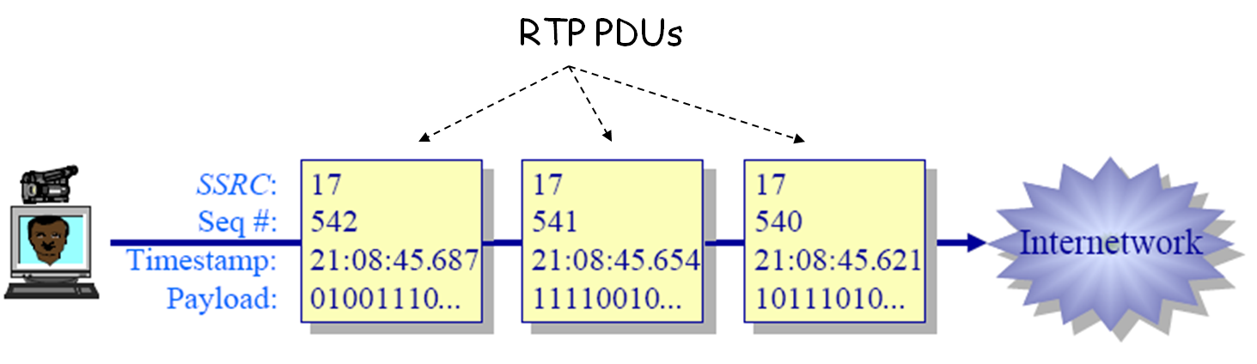
Real-time Streaming

Slide 97
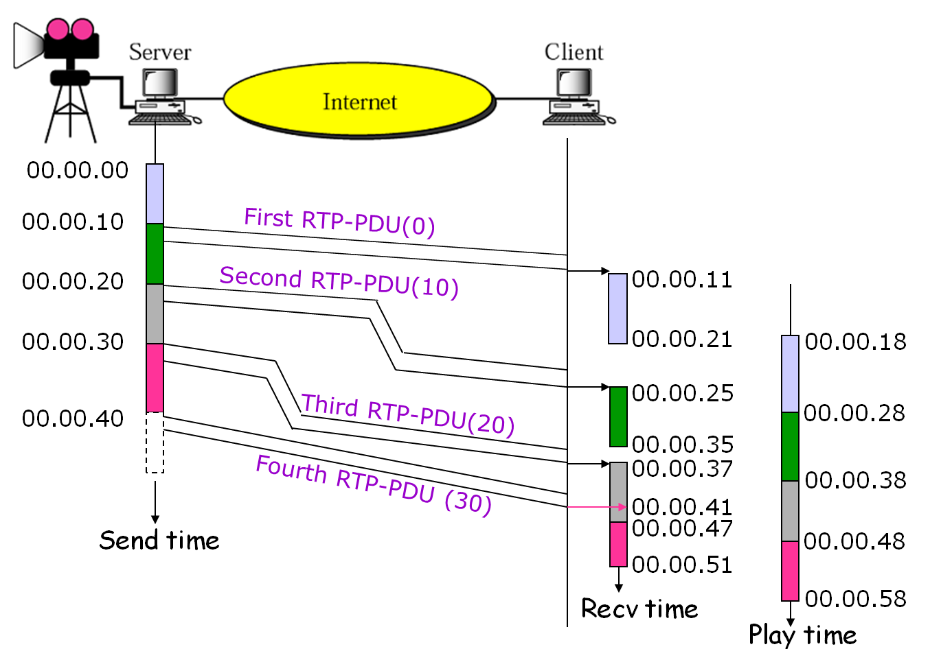
Real-time Streaming

Slide 98
RTP and QoS
RTP does not provide any mechanism to ensure timely data delivery
RTP encapsulation is only seen at end systems, and unseen by intermediate routers
Routers make no special effort for RTP packets

Slide 99
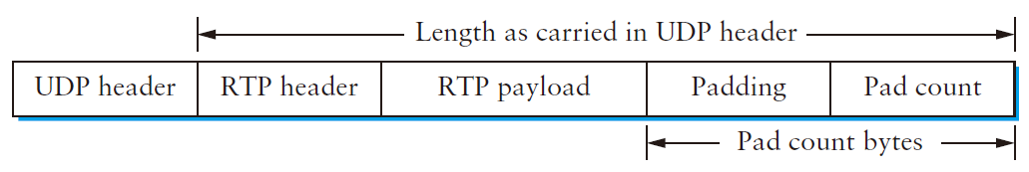
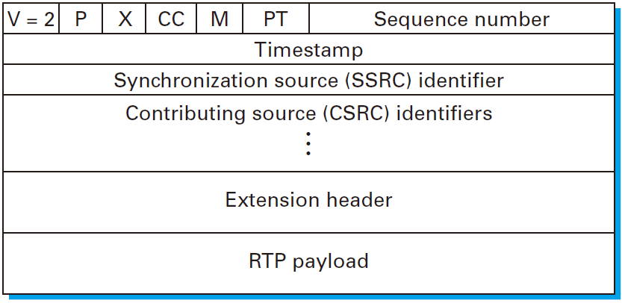
RTP Packets

Slide 100
RTP Header
Version (2 bits)
Version of the protocol, Current 2
P (Padding) (1 bit)
Indicates if there are extra padding octets
X (Extension) (1 bit)
Indicates presence of an extension header
CC (CSRC Count) (4 bits)
Number of CSRC identifiers
M (Marker) (1 bit)
Indicates special relevance for the application

Slide 101
RTP Header
Payload Type (7 bits)
Indicates type of encoding currently being used
Sender can change encoding in middle of session
Example payload:
0: PCM mu-law, 64 kbps
3: GSM, 13 kbps
7: LPC, 2.4 kbps
26: Motion JPEG
31: H.261
33: MPEG2 video

Slide 102
RTP Header
Sequence Number (16 bits)
Increment by 1 for each RTP data packet sent
Timestamp: (32 bits)
Sampling instant of first octet, used for play-back
SSRC (Synchronization source identifier) (32 bits)
Uniquely identifies the source of a stream in a RTP session
CSRC (Contributing source IDs) (32 bits)
Enumerate contributing sources to a stream
Extension header
Specific header for certain payload type

Slide 103
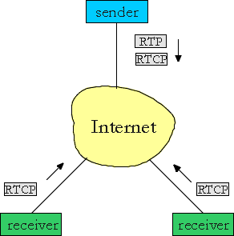
RTP Control Protocol (RTCP)
Specifies report PDUs exchanged between sources and destinations
Receiver reception report
Sender report
Source description report
Reports contain statistics such as the number of RTP-PDUs sent, number of RTP-PDUs lost, inter-arrival jitter
Used by application to modify sender transmission rates and for diagnostics purposes

Slide 104
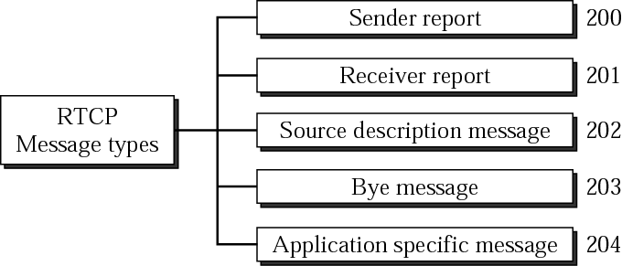
RTCP Message Types
Several RTCP PDUs of different types can be transmitted in a single UDP segment
Notes:
End of participation (BYE)

Slide 105
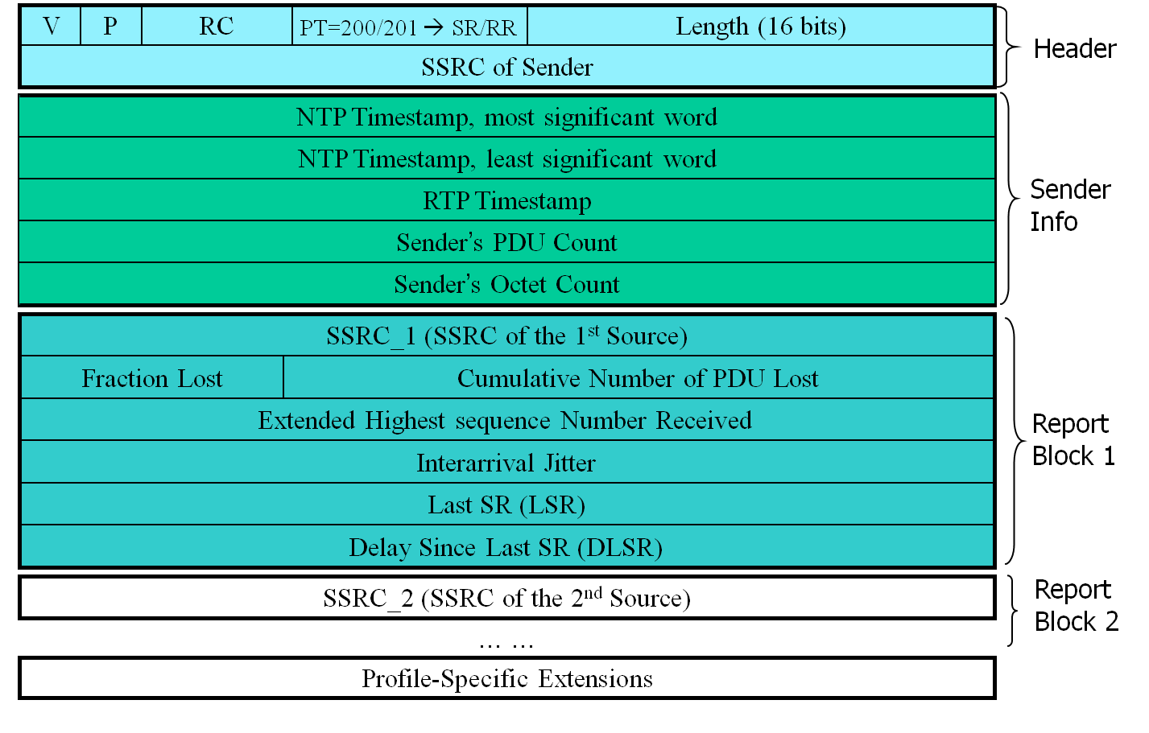
Sender/Receiver Report PDUs
Notes:
Sender report (SR), Receiver report (RR)
padding (P), Reserved (RC), Packet type (PT)
NTP (Network Time Protocol)

Slide 106
Session Initiation Protocol (SIP)
RFC 3261 – an application level protocol
A signaling protocol used for controlling multimedia communication sessions such as voice and video calls over IP
For create, modify and terminate two-party (unicast) or multiparty (multicast) sessions consisting of one or several media streams
An alternative to ITU’s H.323, used for IP Telephony since 1994
Application examples
Video conferencing
Streaming multimedia distribution
Instant messaging
Online games

Slide 107
SIP Services
Setting up a call
Determine current IP address of callee by SIP address
Let callee know caller wants to establish a call
Caller, callee agree on media type, encoding
Call management
Add new media streams during call
Change encoding during call
Invite others, transfer and hold calls

Slide 108
SIP Addressing
Uses Internet URLs
Uniform Resource Locators
Supports both Internet and PSTN addresses
General form is user@host
Examples
sip:alan@wcom.com
sip:J.T. Kirk <kirk@starfleet.gov>
sip:+1-613-555-1212@wcom.com;user=phone
sip:guest@10.64.1.1
sip:790-7360@wcom.com;phone-context=VNET
Notes:
Public Switched Telephone Network

Slide 109
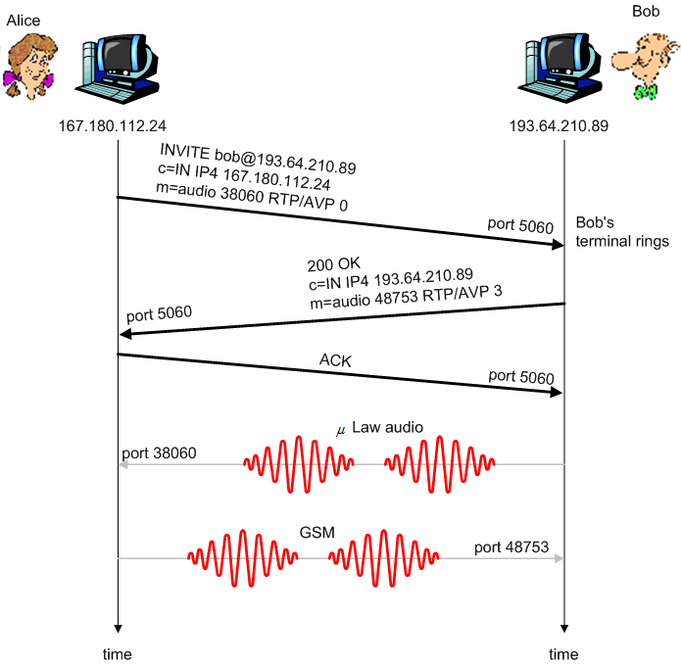
Setting up a Call
Alice’s SIP agent invite msg, indicates her port, IP address, encoding she prefers to receive (PCM μlaw)
Bob’s agent 200 OK msg, indicates his port, IP address, preferred encoding (GSM)
SIP msgs can be sent over TCP or UDP, here sent over RTP/UDP
Default SIP port number is 5060
Notes:
AVP: RTP audio video profile

Slide 110
Other Possible Reply
Rejecting a call
Bob’ agent rejects with “600 busy”, “503 unavailable”, “302 gone”, “401 unauthorized”
Further negotiation
Bob replies with “606 Not Acceptable”, listing his encoders
Alice can then send new “INVITE” message, advertising different encoder

Slide 111
A SIP Request Message
INVITE sip:bob@domain.com SIP/2.0
Via: SIP/2.0/UDP 167.180.112.24:5060
From: sip:alice@hereway.com
To: sip:bob@domain.com
Call-ID: a2e3a@pigeon.hereway.com
CSeq: 1 INVITE
Content-Type: application/sdp
Content-Length: 885
… … …
c=IN IP4 167.180.112.24
m=audio 38060 RTP/AVP 0
Use HTTP message syntax
Via: Shows route taken by request
Call-ID: unique identifier generated by client
CSeq: Command Sequence number, incremented for each successive request
Notes:
Session description protocol

Slide 112
A SIP Response Message
SIP/2.0 200 OK
Via: SIP/2.0/UDP 167.180.112.24:5060
From: sip:alice@hereway.com
To: sip:bob@domain.com
Call-ID: a2e3a@pigeon.hereway.com
CSeq: 1 INVITE
Via, From, To, Call-ID, and CSeq are copied exactly from Request
To and From are NOT swapped

Slide 113
Finding a Callee
SIP address must be transformed to IP address of callee’s current host
Bob may move around, getting different IP addresses (using mobile devices)
Different SIP servers to handle this
Registrar: Accepts REGISTER requests from clients (caller or callee)
Redirect: Sends address of next hop towards callee back to caller
Proxy: Decides next hop and forwards request (as a broker)

Slide 114
SIP Registrar
When Bob starts SIP agent, agent sends SIP REGISTER message to Bob’s registrar server
Similar function needed by Instant Messaging
REGISTER sip:domain.com SIP/2.0
Via: SIP/2.0/UDP 193.64.210.89
From: sip:bob@domain.com
To: sip:bob@domain.com
Expires: 3600

Slide 115
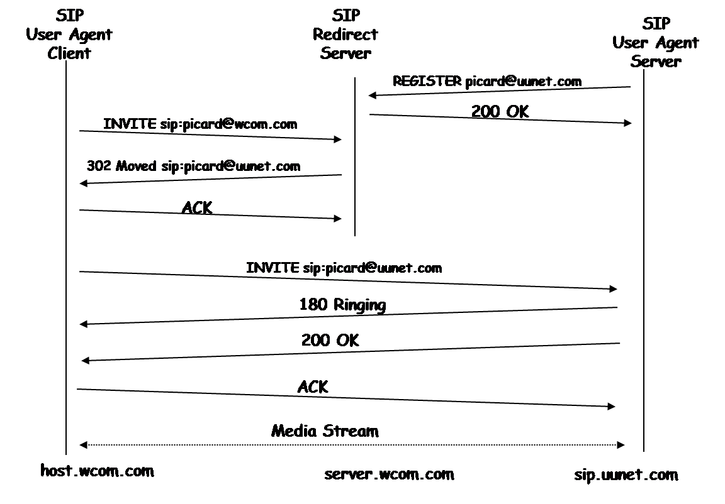
Using Redirect Server

Slide 116
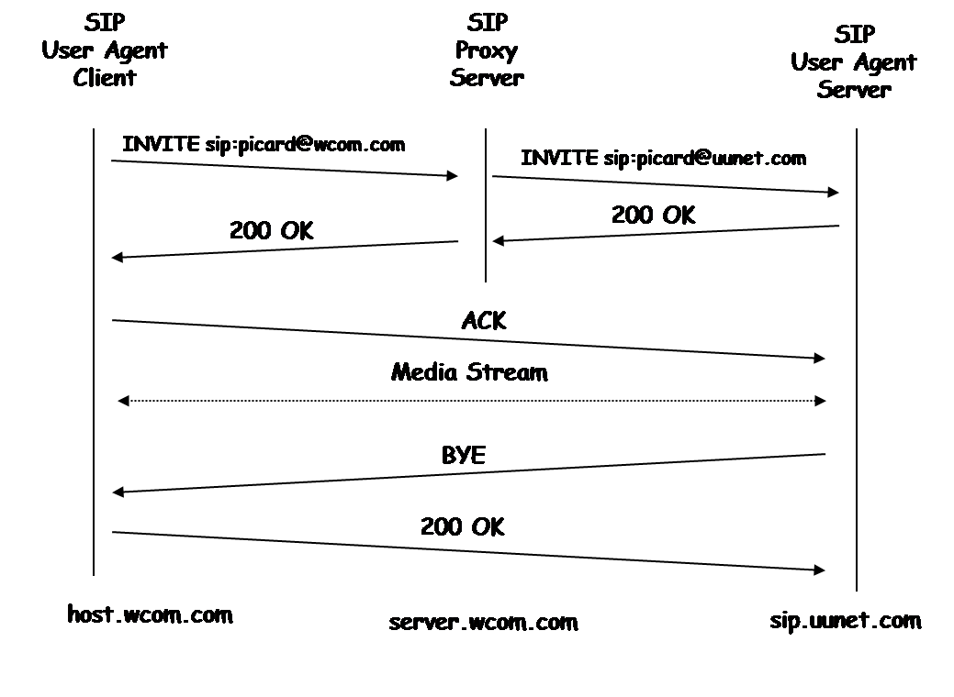
Using Proxy Server

Slide 117
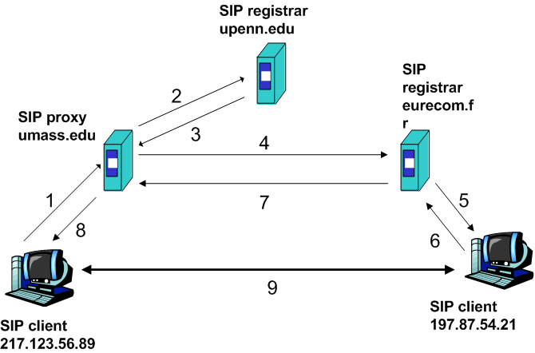
A More Complicated Example
Caller: Bob@umass.edu Callee: Alice@upenn.edu
Bob’s agent sends INVITE message to umass SIP proxy
Proxy forwards request to upenn registrar server
upenn server returns redirect response, indicating that it should try keith@eurecom.fr
umass proxy sends INVITE to eurecom registrar
(5) eurecom registrar forwards INVITE to 197.87.54.21, which is running Alice’s SIP agent
(6-8) SIP response sent back
(9) media sent directly between SIP agents

Slide 118
Real Time Streaming Protocol (RTSP)
RFC 2326
An app-level protocol that establishes and controls media sessions between end points
Support VCR commands: rewind, fast forward, pause, resume, repositioning, etc…
Can built upon UDP or TCP, commands sent in ASCII text
Integration with web architecture, separate stream channel and control channel

Slide 119
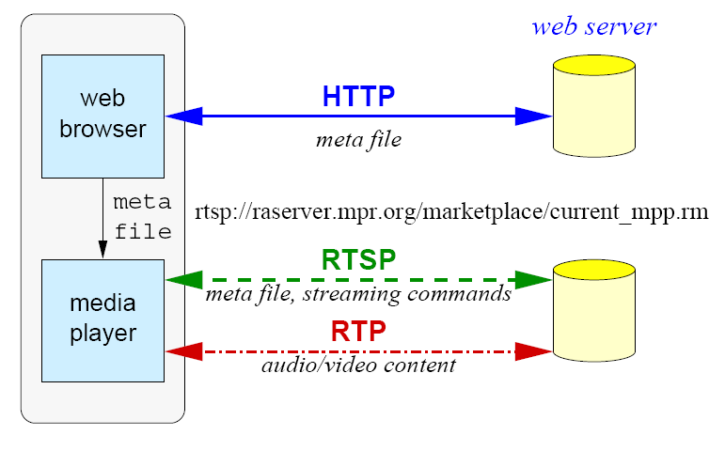
RTSP Scenario
Metafile communicated to web browser using HTTP
Browser launches player
Player sets up an RTSP control connection, data connection to streaming server

Slide 120
A Meta-File Example
<title>Twister</title>
<session>
<group language=en lipsync>
<switch>
<track type=audio
e="PCMU/8000/1"
src = "rtsp://audio.example.com/twister/audio.en/lofi">
<track type=audio
e="DVI4/16000/2" pt="90 DVI4/8000/1"
src="rtsp://audio.example.com/twister/audio.en/hifi">
</switch>
<track type="video/jpeg" src="rtsp://video.example.com/twister/video">
</group>
</session>

Slide 121
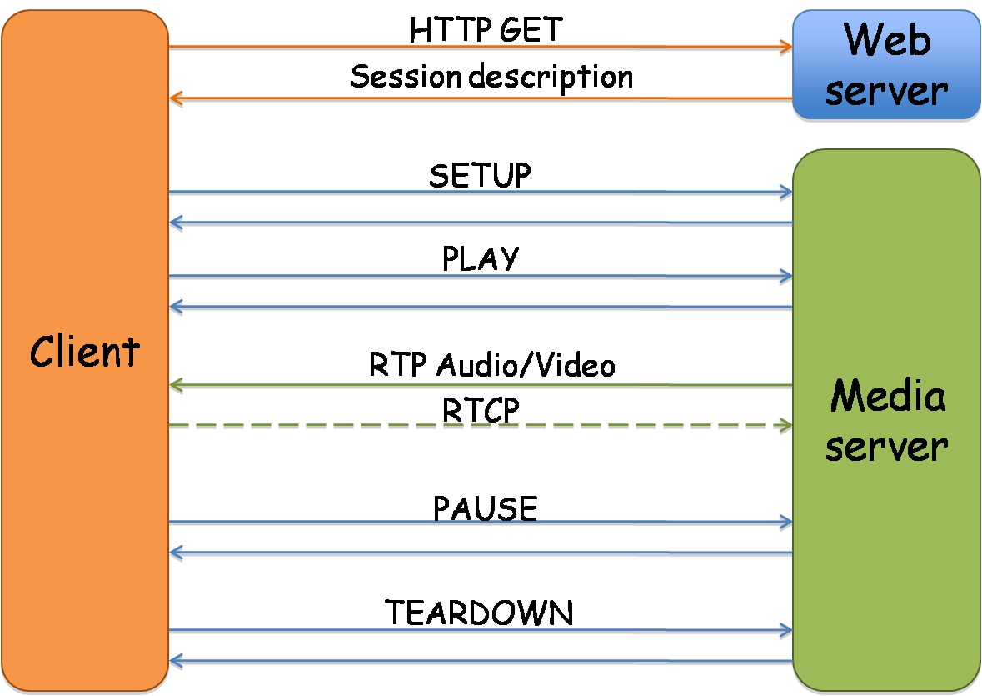
RTSP Operation
Notes:
Description ==Meta file

Slide 122
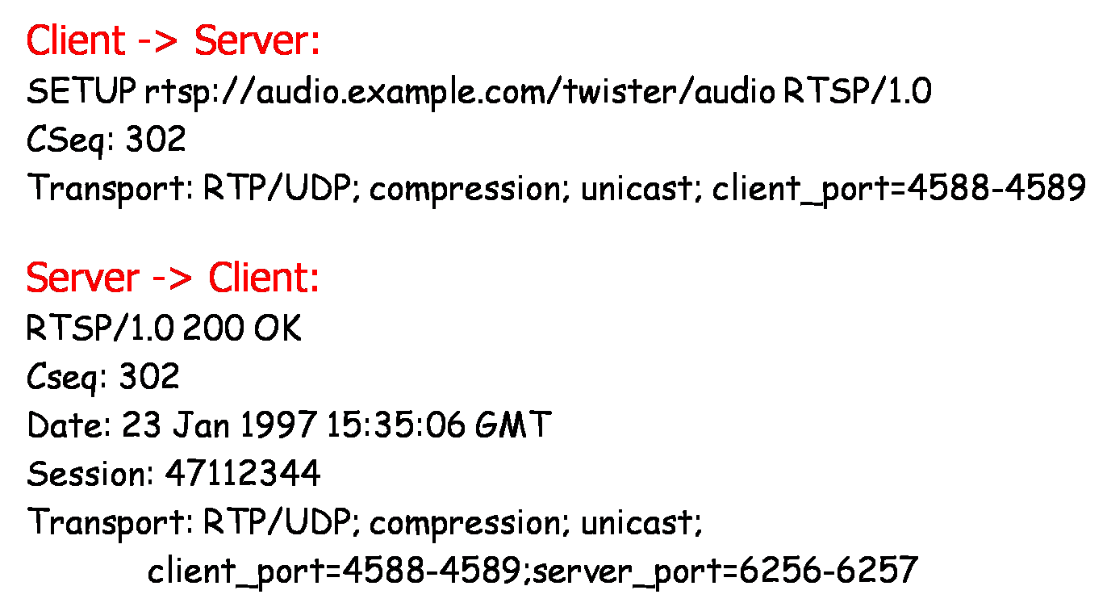
SETUP Example
Specifies the transport mechanism used for streaming media
Client can issue SETUP to change parameters for already started media

Slide 123
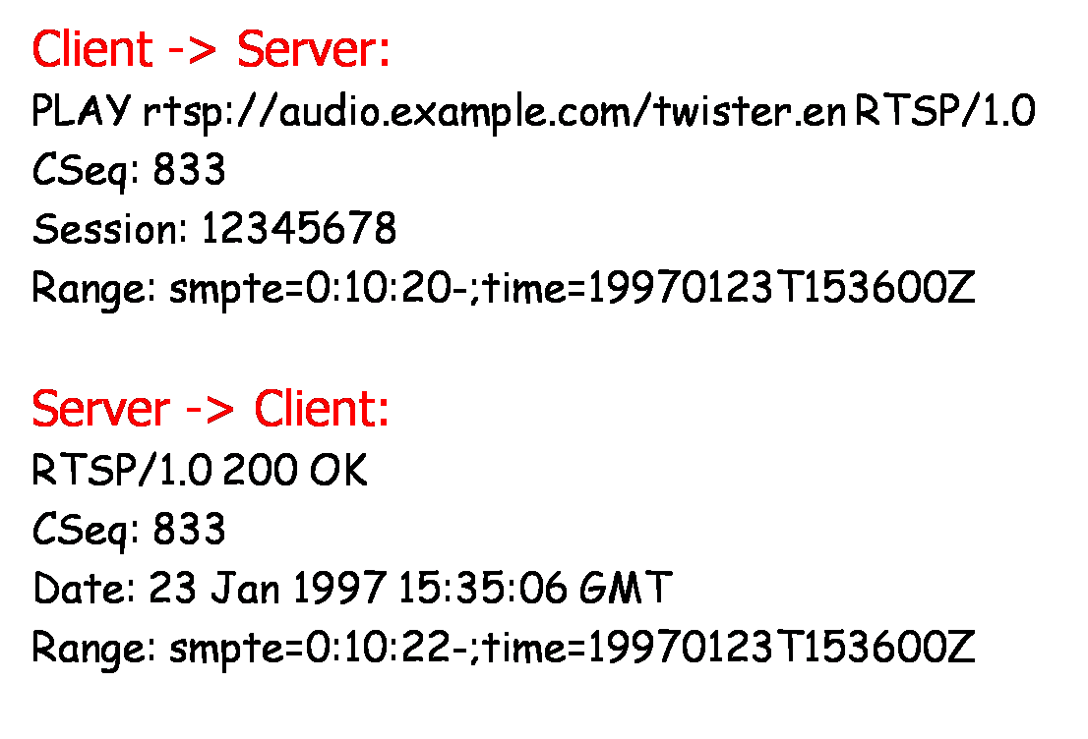
PLAY Example
Plays from beginning to end of range specified
Scale header can be used to change viewing rate
Notes:
Support fast forward

Slide 124
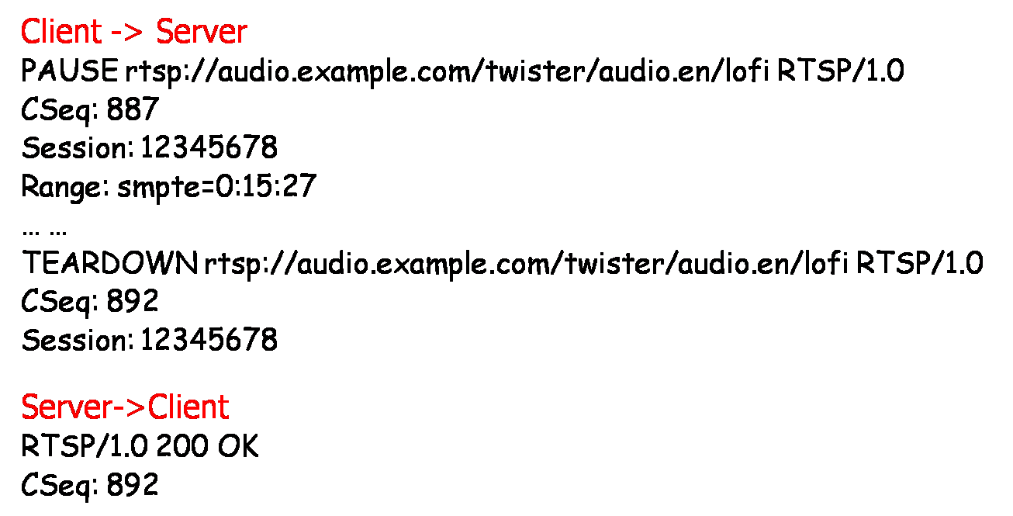
Pause and Teardown
Pause
May contain Range header to specify when to pause
Server will terminate session after timeout period expires
Teardown
Frees up resources on the server

Slide 125
RTSP Reliability
If using TCP message is sent just once
If using UDP, RTSP will retransmit if not receive ACK
Timeout is initially set to 500 ms
Can re-compute timeout based on RTT like TCP
Sequence no is not incremented for retransmission
Timestamp is used to overcome retransmission ambiguity

Slide 126
A Little More
Stream Control Transmission Protocol (RFC 4960)
Message-based multi-streaming, preserves msg order in each stream
Session Announcement Protocol (RFC 2974)
Broadcasting multicast session information
Session Description Protocol (RFC 4566)
Format for describing streaming media initialization parameters
Synchronized Multimedia Integration Language (SMIL)
XML based language for describing multimedia presentations
Timing, layout, animations, visual transitions, and media embedding
Notes:
VCR: Video Cassette Recorder
SCTP: bundling of several connections into a single SCTP association (Transport layer protocol)

Slide 127
Chapter Goals
Principles behind transport layer services
Multiplexing, demultiplexing
3-way handshake
Reliable data transfer
Credit scheme and congestion control
Real-time support
TS implementations in the Internet
TCP and UDP
RTP, SIP and RTSP

